Slide 1





Home
Introduction
Methodology
System Design
Contact
DAYANANDA SAGAR ACADEMY OF TECHNOLOGY AND MANAGEMENT
DETECTING MISSING PERSONS USING AI
PRESENTED BY
SHOBHA D S
UNDER THE GUIDENCE
OF
DR.CHITRA K
1DT22MC044

Slide 2
Contents
Abstract
Introduction
Existing System and Drawbacks
Proposed System and advantages
Hardware and software Requirements
Workflow Diagram
Modules
Implementation
Screenshots
Conclusion
Future Scope

Slide 3
INTRODUCTION
The "Locating Missing Ones" project aims to revolutionize search and rescue by using machine learning and facial recognition in a web application. It enables real-time detection of missing persons through CCTV footage, allowing users to report sightings to the police, enhancing accuracy and efficiency in finding missing people.

Slide 4
Project Overview
Objectives
Streamline missing person search.
Reduce investigation times.
Provide timely notifications to authorities and family members.
System Features
Advanced facial recognition algorithms.
User uploads images of missing persons.
Cross-references with a comprehensive database.
Generates alerts on finding a match

Slide 5
Project Overview
User Roles:
Family members: Upload images and information.
Law enforcement: Efficiently manage and retrieve data through the database

Slide 6
EXISTING SYSTEM AND DRAWBACKS
The challenge in identifying missing children lies in delays that can hinder the search process. Every minute counts, and slow identification reduces the chances of finding a child. AI, particularly LSTM models, enhances accuracy by analyzing case files and matching images with CCTV or social media photos, providing faster, more precise leads and improving search outcomes.
Disadvantages
Time consuming
Negative impact on society
High Complexity

Slide 7
PROPOSED SYSTEM AND ADVANTAGE
This approach leverages machine learning with the Face Recognition package, utilizing the Haar Cascade method and dlib library for facial feature extraction. It processes input images and videos using OpenCV, comparing facial data against a database. If the data matches, the person is identified; if not, the model classifies the individual as unknown.
Advantages:
It increases the accuracy.
Time Complexity
Data Quality
Less Expensive

Slide 8

HARDWARE AND SOFTWARE REQUIREMNTS

Slide 9
Hardware Requirements
Server
Networking
Other Requirements
High-performance server for hosting web applications.
In this project we used our local machine with a server
Reliable and high-speed internet connection for seamless image uploads and data retrieval.
RAM 8 GB or more.
CPU 2.5 GHz.
Architecture 64 bit.
GPU: 4 GB

Slide 10
Software Requirements
Operating System
Database Management System
Programming Language:
Web Framework:
Linux based server operating system for hosting web applications
Used Windows 11 devices.
A database management system (PostgreSQL, MySQL, etc.) To store image data
We used SQLITE database to store the data.
Python as the central programming language for system development
Django web framework for building web applications.
Django’s ORM for database interaction

Slide 11
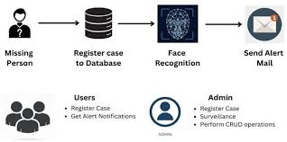
WORKFLOW DIAGRAM

Slide 12
MODULES
Admin Module
1) System Configuration and Management
a) Data Source Management: Admins can define trusted sources for data acquisition, including authorized access to public and private surveillance feeds, social media platforms (with user consent agreements), and phone network data (with legal authorization).
b) User Management: Admins can create and manage user accounts for authorized law enforcement personnel and search teams. Assigning access levels and permissions ensures data security and restricts unauthorized use

Slide 13
MODULES
2) Data Security and Privacy Controls
a) Data Anonymization: Admins can configure the system to anonymize facial data whenever possible during analysis, minimizing privacy concerns.
b) Data Access Logs: Admins can review and access the data logs which enables to monitoring of user activity and ensure that the authorized personnel are using the system appropriately.

Slide 14
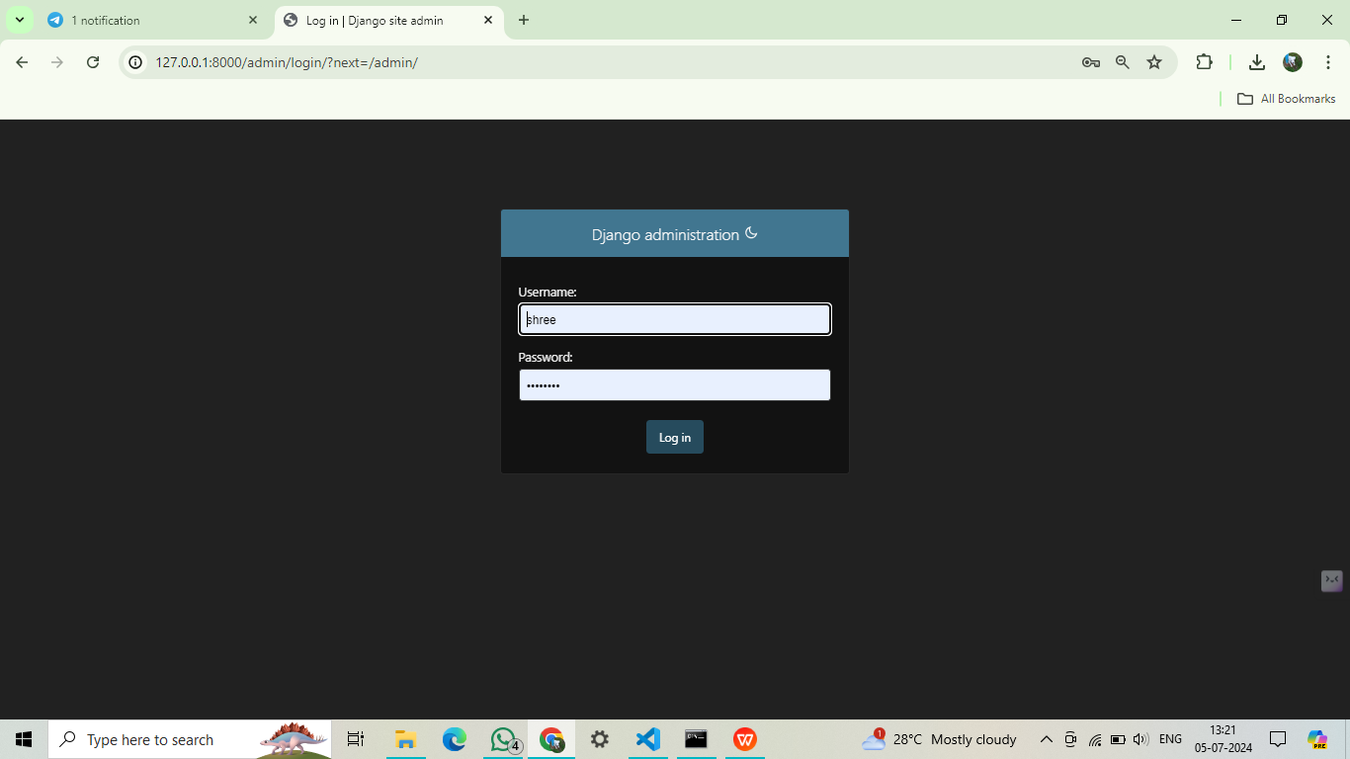
ADMIN PAGE

Slide 15
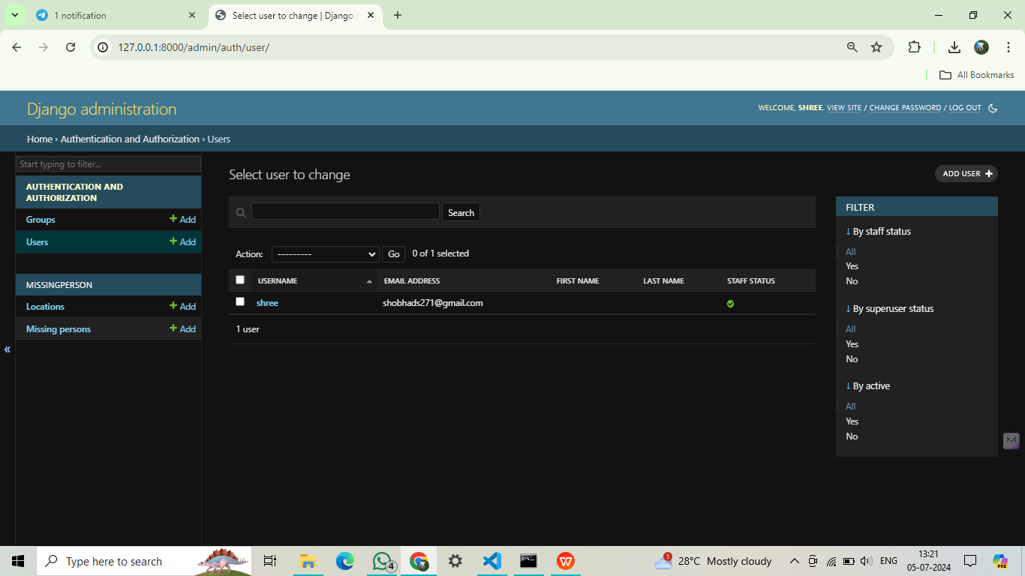

Slide 16
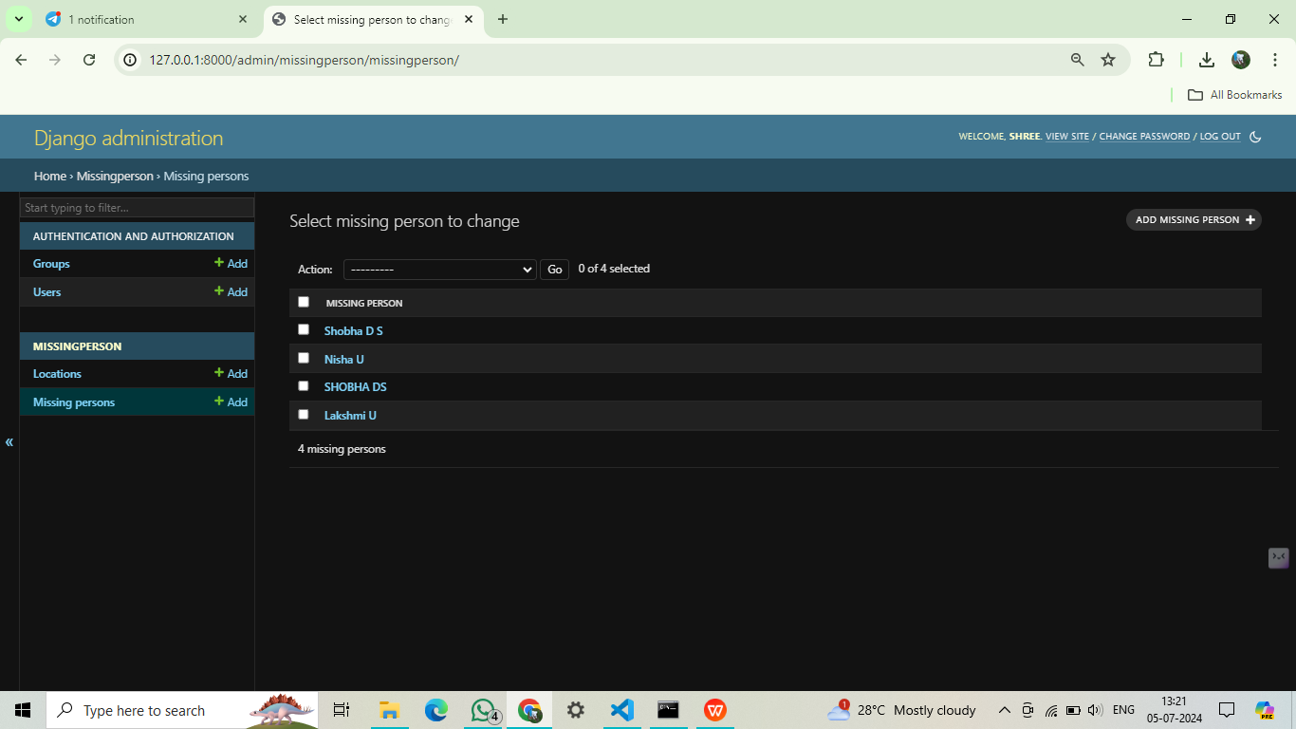

Slide 17
MODULES
User Module
Add missing person details module
Face Recognition
Missing Person Details Module:Captures and stores detailed information for each missing person, including personal data, last known location, and photos.
Face Recognition: Uses AI/ML to analyze and match facial features for accurate identification.

Slide 18
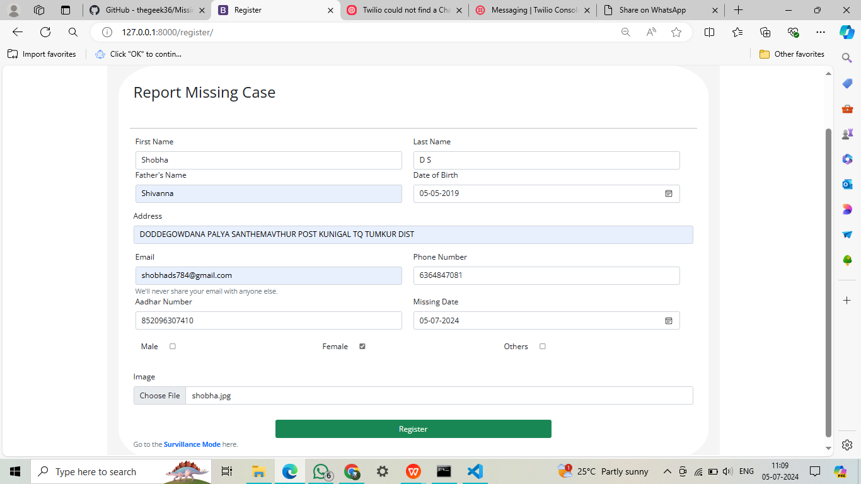
Add missing person details module

Slide 19

Face Recognition module

Slide 20
IMPLEMENTATION
1. Project Initialization
Modules: django-admin, startproject, startapp
Tasks:
Set Up Project: Create a new Django project and initialize two key apps: detection (for AI-driven person identification) and administration (for data management and admin functions).
2. Database Schema Design
Modules: models, migrations
Tasks:
Define Data Models: Establish the schema for storing missing persons' information, including fields for personal details and images.
Apply Migrations: Create and apply migrations to set up the database structure.

Slide 21
IMPLEMENTATION
3. AI Model Development
Modules: TensorFlow/Keras or PyTorch (for model training), OpenCV (for image processing)
Tasks:
Model Selection/Training: Choose or train a facial recognition model using a dataset of missing persons.
Model Serialization: Save the trained model for integration into the Django application.
4. Backend Integration
Modules: Django Views, Django Forms, TensorFlow/PyTorch (for loading the model), NumPy (for processing images)
Tasks:
Load AI Model: Integrate the AI model into the Django backend.
Develop Image Processing Logic: Create functions to preprocess uploaded images and compare them with database images for matches.

Slide 22
IMPLEMENTATION
5. Frontend Development
Modules: Django Templating Engine, HTML/CSS, JavaScript (for enhanced user interaction)
Tasks:
Design User Interfaces: Develop templates for image uploads, match results, and admin dashboards.
Implement Forms: Create forms to allow users to upload images for identification.
6. Admin Interface Configuration
Modules: Django Admin
Tasks:
Admin Dashboard: Configure the Django admin interface to manage and update the database of missing persons, including the ability to add, edit, and remove records.

Slide 23

SCREENSHOTS

Slide 24
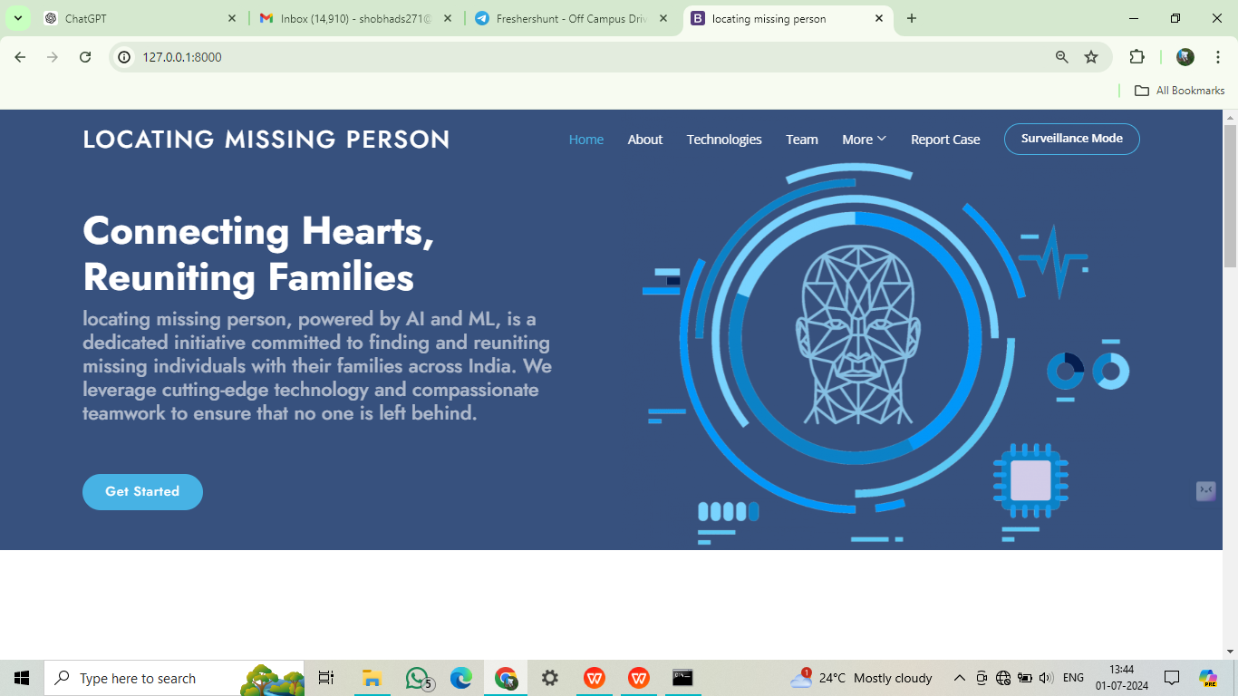
LANDING PAGE

Slide 25
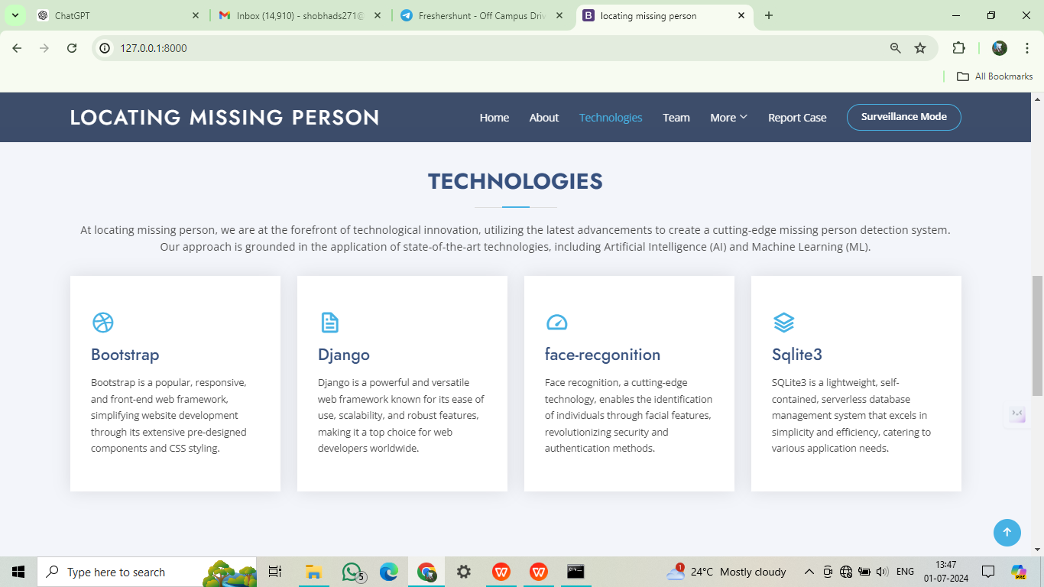
TECHNOLOGIES PAGE

Slide 26
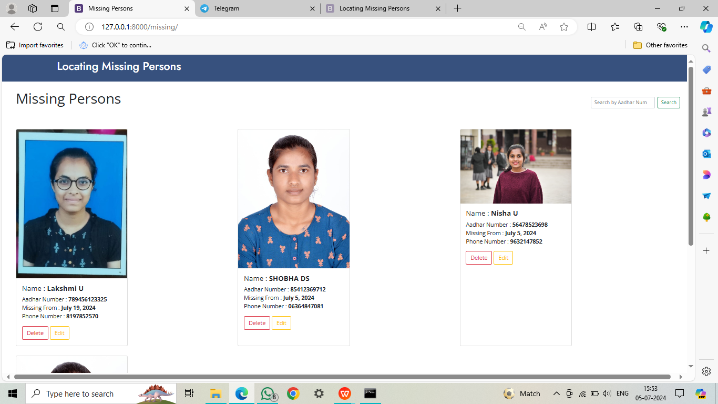
LIST OF MISSING PERSONS

Slide 27
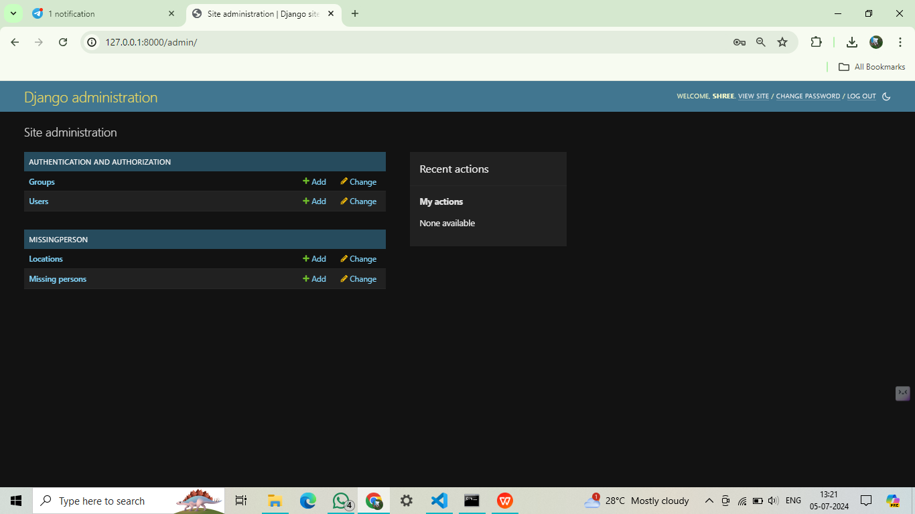
ADMIN PAGE

Slide 28
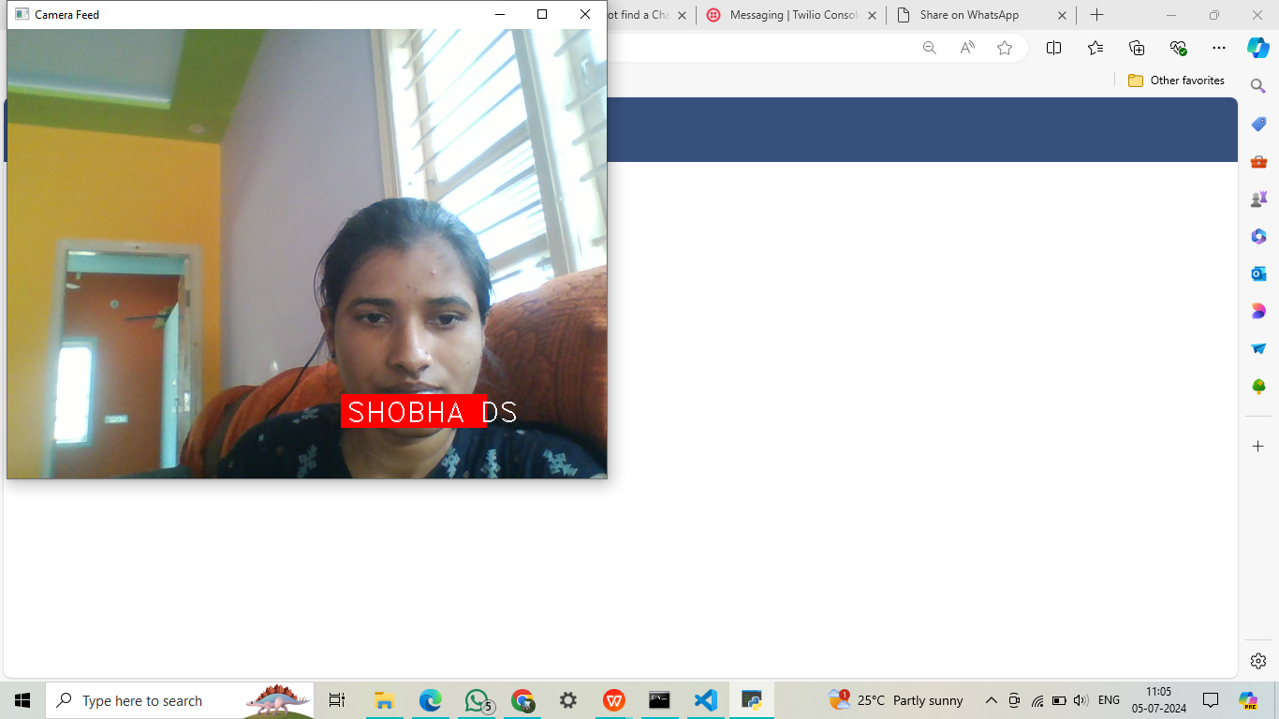
CAMERA FEED

Slide 29
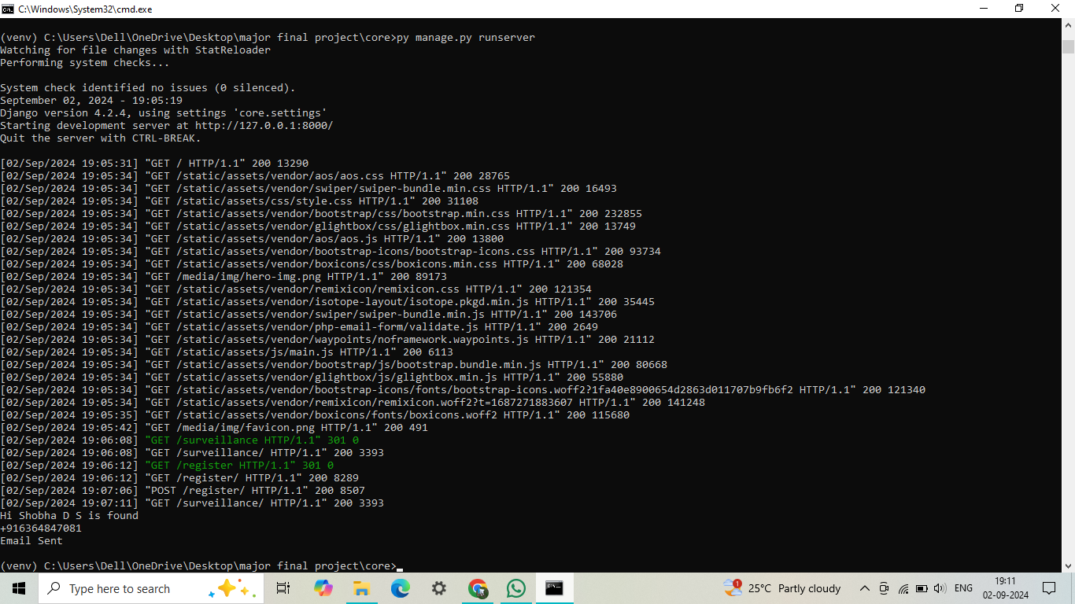
Output

Slide 30
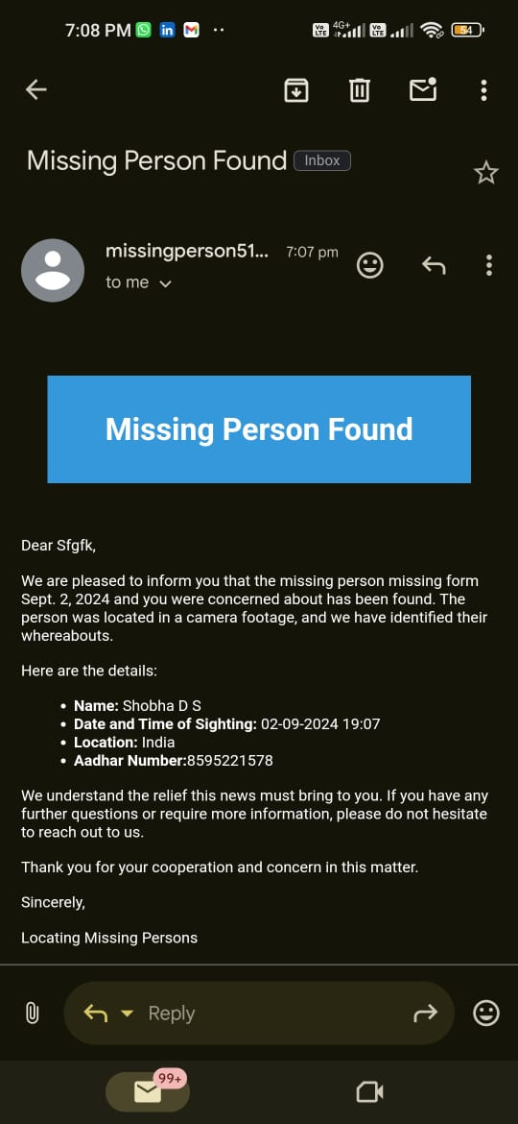
Alert notification

Slide 31
Conclusion
Significance of the Missing Person Detection System: Revolutionizing the search for missing individuals.
Potential for Saving Lives: Timely identification and rescue of missing persons.
Contribution to Society: Enhancing public safety and reducing anxiety among families of missing persons.

Slide 32
Future Scope
Real-Time Video Analysis Integration.
Mobile Application Development.
Collaboration with Law Enforcement Agencies,
Integration with Social Media Platforms.
Integration with Public Services.
Implementing encryption protocols and data privacy.
Incorporating geolocation services and camera metadata.
Deploying the system on cloud services like AWS, Azure, or Google Cloud.

Slide 33
Benefits and Impact
Rapid image uploads allow for quicker initiation of the search process.
OpenCV & face-recgonition ensures precise facial feature extraction, enhancing the accuracy of face encodings during matching.
Organized database ensures comparison during facial recognition
Automatic alert generation for authorities and concerned individuals.
Reduces the overall time and resources traditionally required for missing person investigations. The project sets the stage for advancements in missing person detection, with potential applications extending beyond current boundaries.

Slide 34
Challenges & Mitigations
Challanges
Accuracy of Facial Recognition.
Protecting the privacy of individuals.
Handling large volumes of image data and processing.
Collaborating with law enforcement agencies.
Mitigations
Advanced Facial Recognition Algorithms.
Secure Data Storage and Encryption.
Optimizing machine learning models to reduce computational complexity.
Standardized Data Exchange Protocols.

Slide 35












THANK YOU

